Slide 1
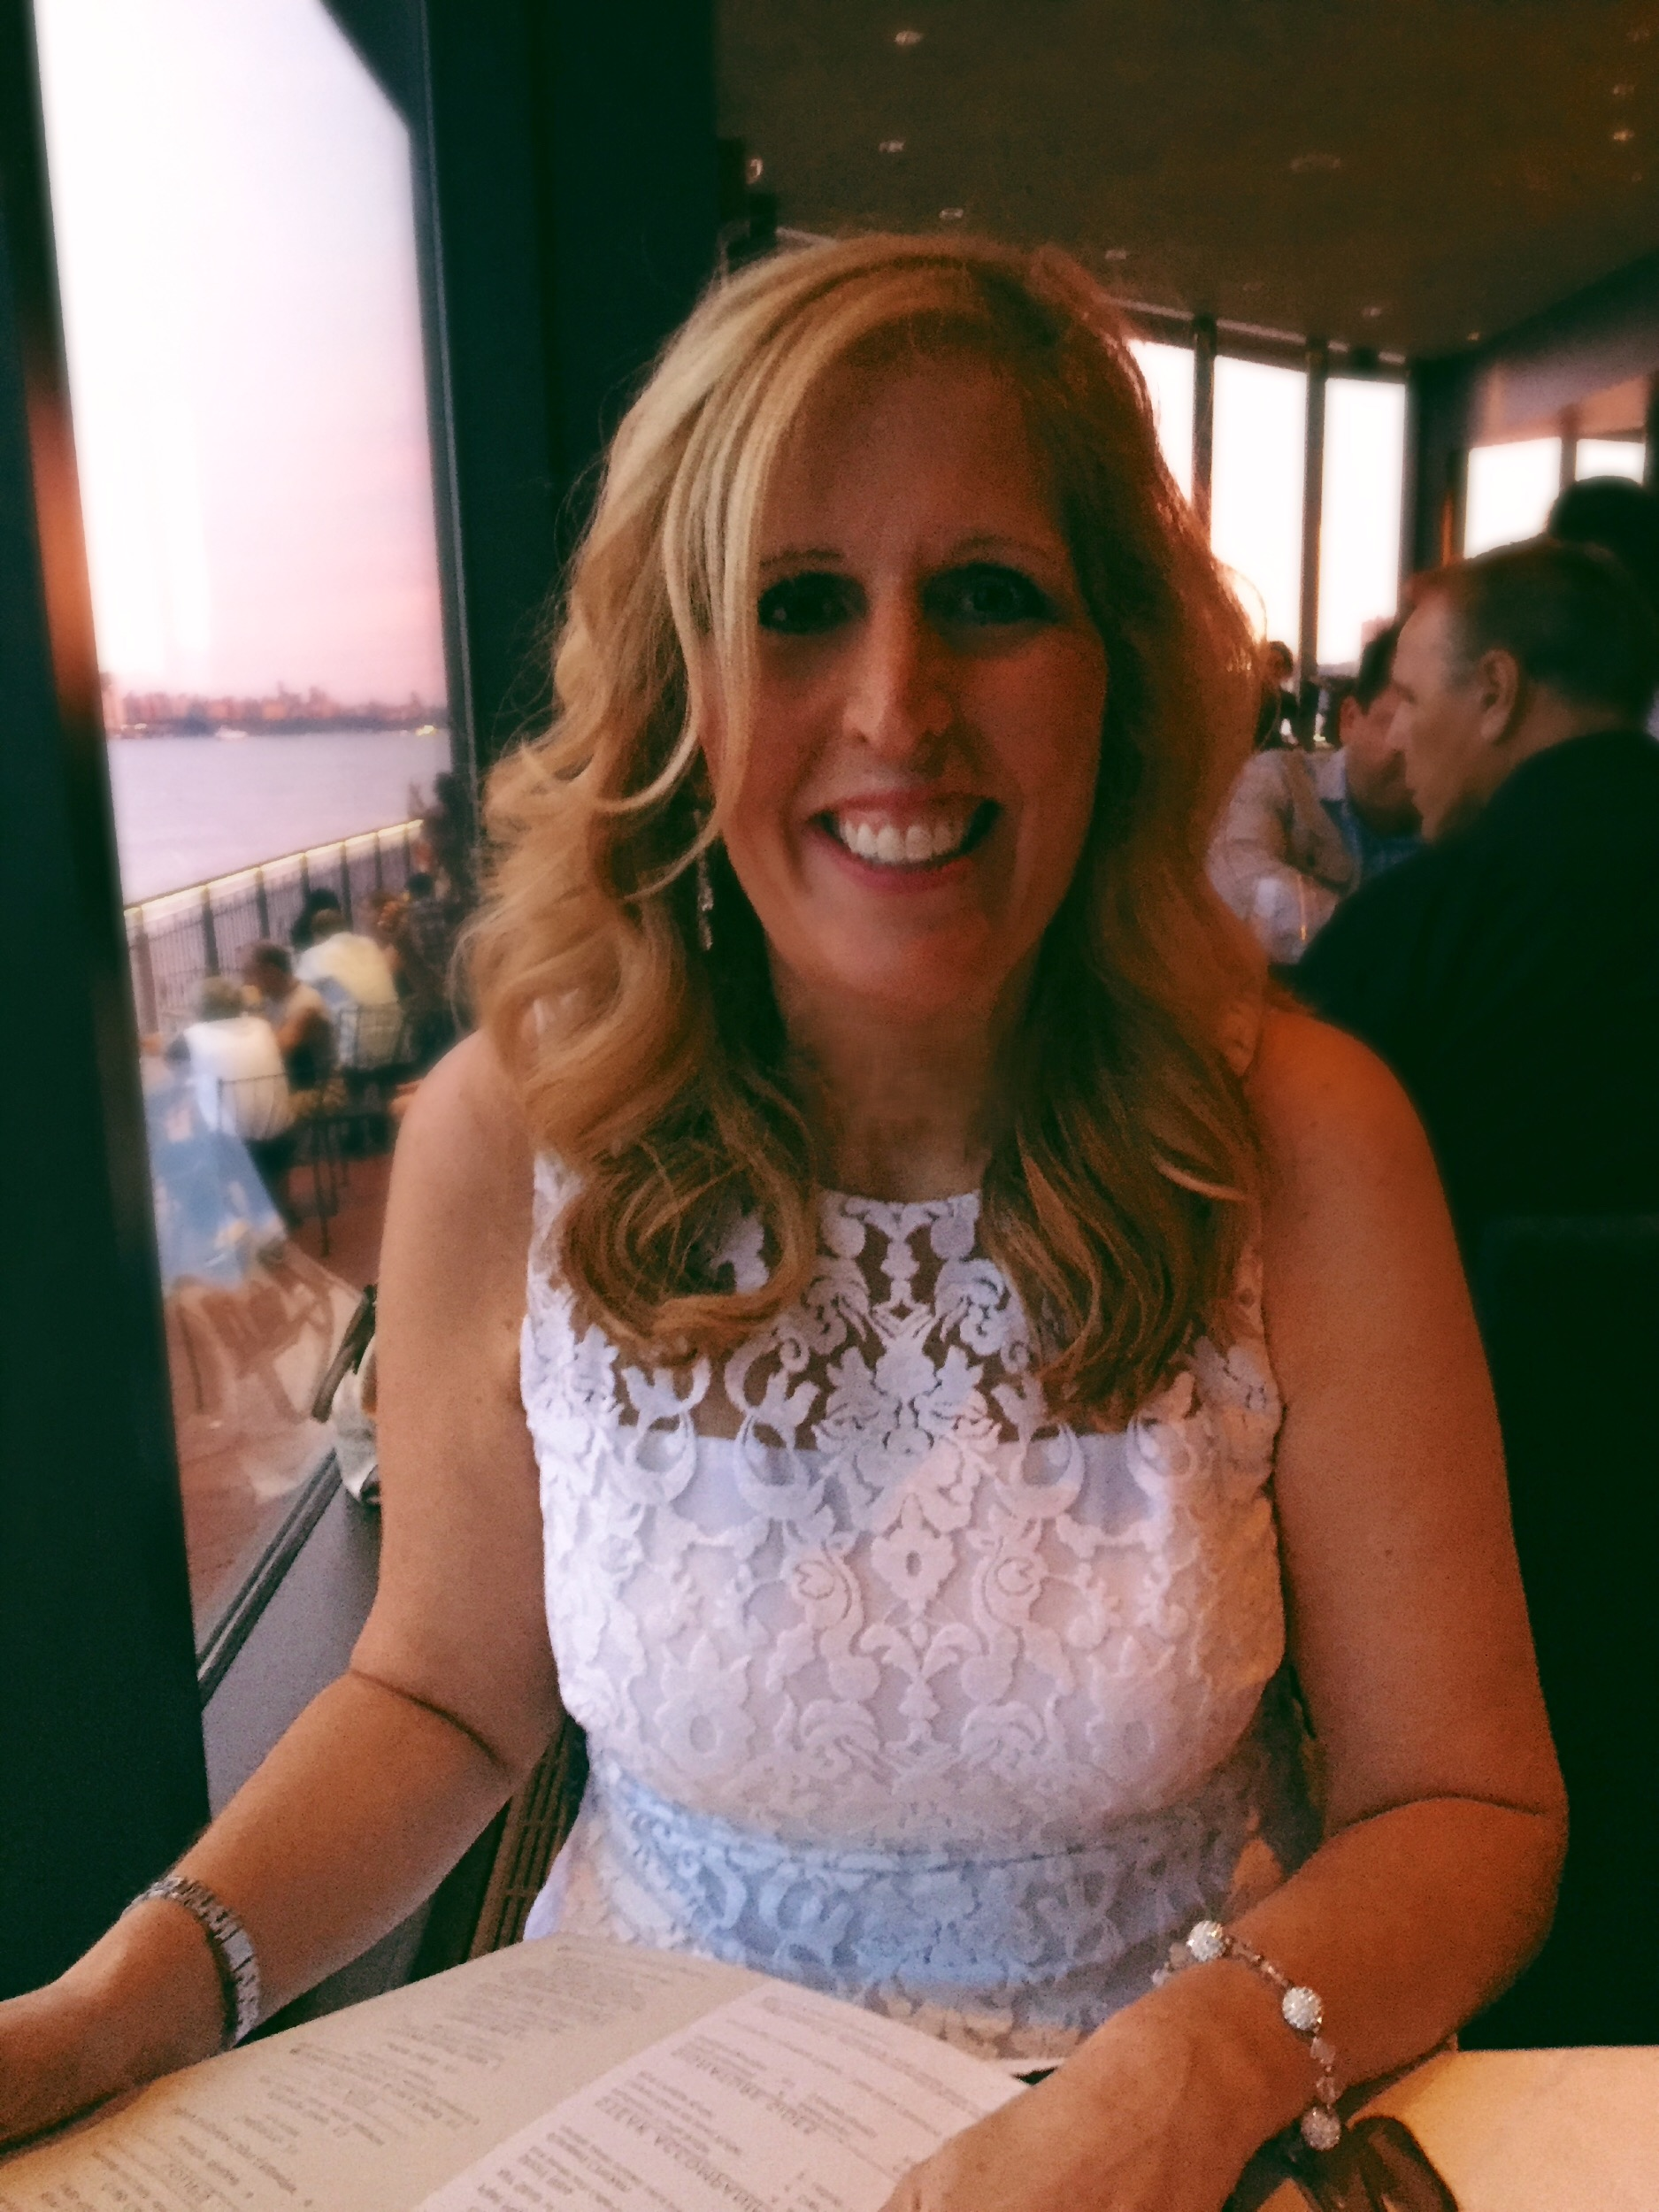
Mrs. Seaman
Physics & Environmental Science Teachers
Perth Amboy High School
Freshman Academy
2020-2021 School Year

Slide 2
About Me: Tami Seaman
Professional Information: I am an educator with over 14 years of experience. I have taught classes in Physics, Chemistry, Environmental Science, Biology, Algebra I, Algebra II and Reading. In addition, I have an extensive background working with exceptional learners to help them achieve their full potential. This will be my eighth year teaching at Perth Amboy High School.
Personal Information: I am married and the proud mother of three boys. My oldest son graduated from Brandeis University in Boston and is currently working as a Systems Administrator.. My other sons attend Rutgers University. The middle son will be graduating in the Fall and going on to be a Physical Therapist. My youngest son is in the Engineering Program working on a double major in Biochemical Engineering and Biomedical Engineering.

Slide 3
Colleges Attended:
Emory University, Atlanta, GA- Undergraduate Bachelor’s Degree
Seton Hall University, South Orange, NJ- Master’s Degree
Rutger’s University- Teaching Degree
Rowan University- Special Education Certification
I am a lifelong learner committed to the teaching profession. My goal is to inspire others to learn and be the best that they can be!
"To me there is nothing more fulfilling than knowing that you have made a difference in a child’s life. “

Slide 4
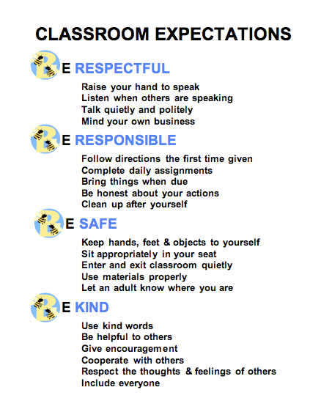
Classroom Expectations

Slide 5
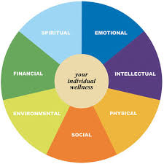
Academic Expectations
“Creating a culture of High Expectations, Student Motivation and Instructional Support
that promotes success for every student”
Communicate Effectively Through
Listening, Speaking and Writing.
Read fluently, critically and with understanding.
Use of technology and various tools to locate, organize and process information from various sources.
Public Speaking, performing and creating to express ideas.
Identifying, Clarifying, and describing issues/problems
Utilizing thinking skills and reasoning strategies.
Analyzing and Solve Problems Effectively by questioning, identifying, observing, hypothesizing, experimenting, and concluding.
BE THE BEST THAT YOU CAN BE!

Slide 6
Things you’ll see in our classroom…..
Cornell Note Taking/Reference
Do Nows/Exit Slips
Classroom Discussions
Inquiry Based Labs
Social and Emotional Learning
Science and Literacy Practice
Key Words/ Word Morphology
Study Guides
Use of Technology/Research
News/Media
Mnemonics/Analogies
Bulletin Boards/Jam Boards
Technology
Online Interactive Labs
Reflections
Demonstrations
Cross Curriculum lessons
Differentiated Instruction
Small Group Activities
Whole Group Activities
Individual Activities
Formal and Summative Assessments
Social and Emotional Growth
Reflection
Questioning
Collection of Data/Graphing
Safe Environment
Happy Faces

Slide 7
Physics Topics Covered:
Scientific Fundamentals
Kinematics
Dynamics
Vectors
Two Dimensional Motion
Momentum
Work and Energy
Circular Motion
Gravity
Electrostatics
Electric Current and Circuits
Magnetism
Electromagnetism
Waves
Sound
Light

Slide 8
Environmental Science
Topics Covered:
Intro to Environmental Science
Ecology
Populations
Earth’s Resources
Human’s and the Environment
Sustainable Future

Slide 9
Classroom Policies
Students will sign in and come to class consistently
Students enter the class on time
Students are in appropriate school dress
Students are not permitted to use Cell Phone during class
Students are not allowed to chew gum/eat food during class
Bullying, Cyberbulllying and Cursing are not allowed
Students hand in Do Nows, homework, classwork, quizes and tests on a timely basis.
Classroom Discussion/ Participation is encouraged
Take Notes and Stay Focused
Small Group Work Participation and Cooperation in breakout rooms
Practice Activity/Lab Work
Respect Others and yourself
Respect Property of others and the school
Stay on Task
Use Technology Responsibly
Try your best!
Ask for help if you don’t understand

Slide 10
Questions/Answers

Slide 11
Grading
Grading is based on accumulated points from both formative and summative assessments such as:
Tests, Quizzes (60%) , Classwork (35%), , Homework, Notes,
Participation (5%)

Slide 12
Our Goals as Teachers
Serve as Mentors
Instill the Love of Learning
Keep Students Engaged
Constantly seeking out opportunities for Professional Development
Show student growth in learning and social development
Create an accepting and safe environment
Increase Interest in the Sciences
Prepare students for college and professional success!

Slide 13
Parent Involvement Needed
Parents/Guardians as Models
Parents/guardians have a tremendous impact on children's behavior. What they observe in adults becomes a standard of behavior.
Create an appropriate study environment
Create a predictable routine if possible
Take time to listen or talk to your child about how their day is going
Make student eats a well balanced diet
Be a partner with your child and child’s teacher
Serve as a role model for your student
Give your child love and support

Slide 14
Contact Information
We can be reached via phone email during school hours. We will be available via phone during Period 1, M, W, Th, F (8:05-8:47am)
Our email addresses are:
Richkaier@paps.net and Tamiseaman@paps.net

